Slide 1
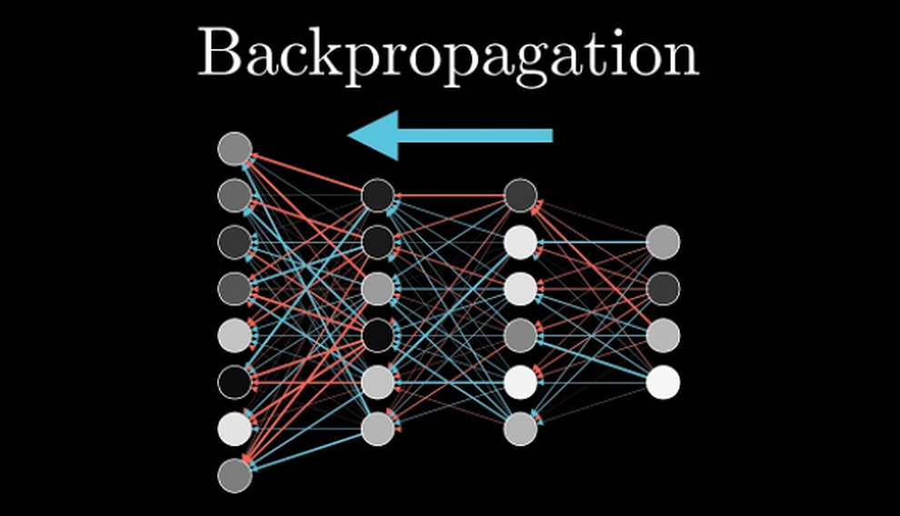

Slide 2

기본적인
미분.....
>>>>>> Peter Jeong

Slide 3
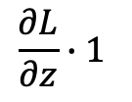
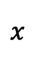
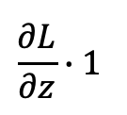
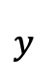

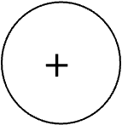
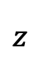
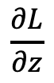
덧셈 미분: $x+y$
$$\frac{∂L}{∂z}∙1$$
$$x$$
$$\frac{∂L}{∂z}$$
$$+$$
$$z$$
+
$$y$$
$$\frac{∂L}{∂z}∙1$$

Slide 4
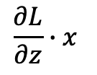
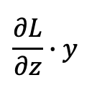

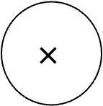
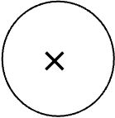
곱셈 미분: $x × y$
$$\frac{∂L}{∂z}∙y$$
$$x$$
$$\frac{∂L}{∂z}$$
$$×$$
$$z$$
$$×$$
$$y$$
$$\frac{∂L}{∂z}∙x$$

Slide 5
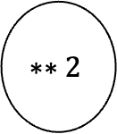
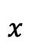
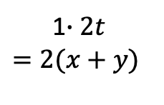
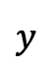
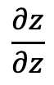
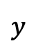
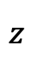
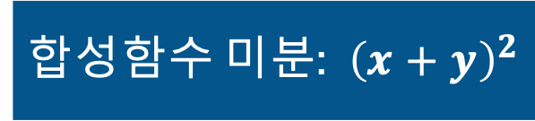
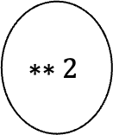
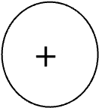
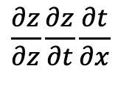
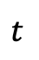
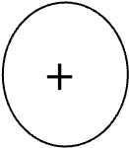
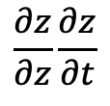
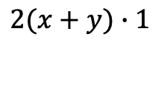
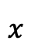
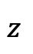
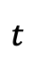
합성함수 미분: ${\left(x+y\right)}^{2}$
$$x$$
$$t$$
$$z$$
$$+$$
$$∗∗2$$
$$\frac{∂z}{∂z}\frac{∂z}{∂t}\frac{∂t}{∂x}$$
$$\frac{∂z}{∂z}$$
$$y$$
$$\frac{∂z}{∂z}\frac{∂z}{∂t}$$
$$x$$
$$t$$
$$z$$
$$+$$
$$∗∗2$$
$$2(x+y)∙1$$
1
$$y$$
1$∙2t$
$$=2(x+y)$$

Slide 6
ReLU 함수 미분으로.....
>>>>>> Peter Jeong

Slide 7
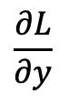
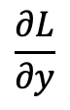
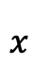
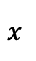
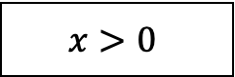
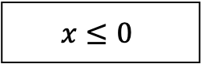
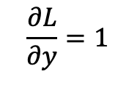
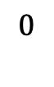
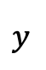
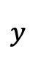
Relu 함수
$$x>0$$
$$x≤0$$
$$x$$
$$y$$
$$x$$
$$y$$
relu
relu
$$\frac{∂L}{∂y}$$
$$\frac{∂L}{∂y}$$
$$\frac{∂L}{∂y}=1$$
$$0$$

Slide 8
Sigmoid 함수 미분으로.....
>>>>>> Peter Jeong

Slide 9
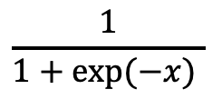
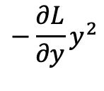
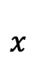
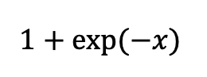
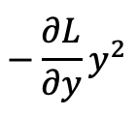
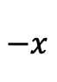
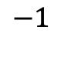
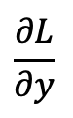
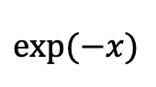
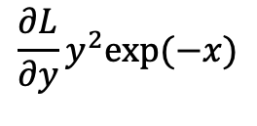




sigmoid 함수
$$\frac{1}{1+exp(−x) }$$
$$x$$
$$−x$$
$$exp(−x)$$
$$1+exp(−x)$$
$$x$$
$$exp$$
+
/
$$\frac{∂L}{∂y}y^{2}exp⁡(−x)$$
$$−\frac{∂L}{∂y}y^{2}exp⁡(−x)$$
$$−\frac{∂L}{∂y}y^{2}$$
$$−\frac{∂L}{∂y}y^{2}$$
$$\frac{∂L}{∂y}$$
$$−1$$
$$1$$

Slide 10








sigmoid 함수
$$x$$
$$y$$
$$x$$
$$y$$
sigmoid
sigmoid
$$\frac{∂L}{∂y}$$
$$\frac{∂L}{∂y}y^{2}exp⁡(−x)$$
$$\frac{∂L}{∂y}$$
$$\frac{∂L}{∂y}y(1−y)$$

Slide 11
Affine
계층으로.....
>>>>>> Peter Jeong

Slide 12












순전파
역전파
$$\left(2,\right)$$
$$X$$
$$\left(2,\right)$$
$$X$$
$$\left(3,\right)$$
$$X∙W$$
$$\left(3,\right)$$
$$Y$$
$$\frac{∂L}{∂Y}∙W^{T}=\frac{∂L}{∂X}$$
(3, ) (3,2) (2,)
$$\left(3,\right)$$
$$X∙W$$
$$dot$$
$$+$$
$$dot$$
$$\left(2,3\right)$$
$$W$$
$$\frac{∂L}{∂Y}$$
(3,)
$$\left(2,3\right)$$
$$W$$
(3,)
B

Slide 13











역전파
$$\left(2,\right)$$
$$X$$
$$\frac{∂L}{∂X}=\frac{∂L}{∂Y}∙W^{T}$$
(2,) (3,) (3,2)
$$\left(3,\right)$$
$$X∙W$$
$$\left(3,\right)$$
$$Y$$
$$dot$$
$$+$$
$$\frac{∂L}{∂Y}$$
(3,)
$$\frac{∂L}{∂Y}$$
(3,)
$$\left(2,3\right)$$
$$W$$
$$\frac{∂L}{∂W}=X^{T}∙\frac{∂L}{∂Y}$$
(2,3) (2,1) (1,3)
$$\frac{∂L}{∂Y}$$
(3,)
(3,)
B

Slide 14








역전파
$$\left(N, 2\right)$$
$$X$$
$$\frac{∂L}{∂X}=\frac{∂L}{∂Y}∙W^{T}$$
(N, 2) (N, 3) (3,2)
$$\left(N,3\right)$$
$$X∙W$$
$$\left(N, 3\right)$$
$$Y$$
$$dot$$
$$+$$
$$\frac{∂L}{∂Y}$$
(N, 3)
$$\frac{∂L}{∂Y}$$
(N, 3)
$$\left(2,3\right)$$
$$W$$
$$\frac{∂L}{∂W}=X^{T}∙\frac{∂L}{∂Y}$$
(2,3) (2,N) (N,3)
$$\frac{∂L}{∂B}=\frac{∂L}{∂Y}$$
(3, ) (N, 3)
(3,)
B

Slide 15
Softmax-with-Loss
계층으로.....
>>>>>> Peter Jeong

Slide 16

순전파와 역전파

Slide 17

Softmax 순전파

Slide 18

Cross Entropy Error 순전파

Slide 19

Cross Entropy Error 역전파

Slide 20

역전파 1단계

Slide 21

역전파 2단계

Slide 22

역전파 3단계

Slide 23

역전파 4단계

Slide 24

역전파 5단계

Slide 25

역전파 6단계

Slide 26

Softmax-with-Loss 계층

Slide 27
역전파의 장점
수치미분에 비해 오차가 없고 수행 속도가 빠르고 정확한 미분값을 산출할 수 있다.

Slide 28
Majored to
Application Mathmematic
in Pukyong Unv.
Abouts
Me
Studying
Deep Neural Network
& Reinforcement Learning
in Pukyong Unv.

Slide 29
Thank you for
Your attention
P Presentor
P Jeong Tae Gung

